Slide 1
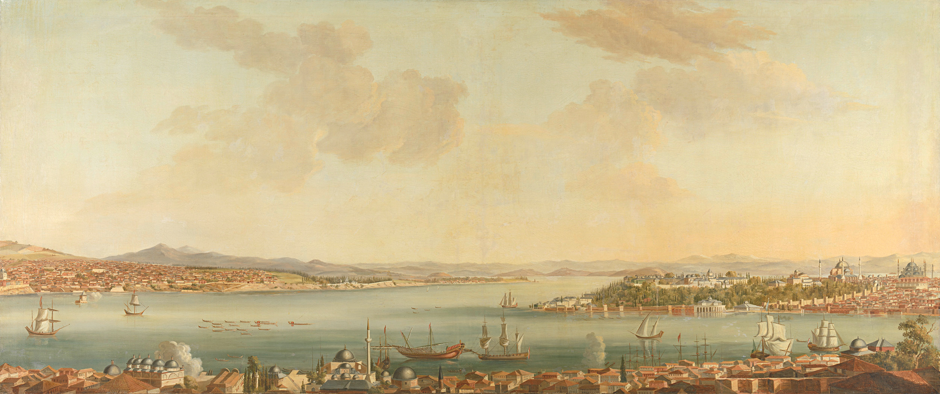

The leaders of the First Philippine Republic

Slide 2

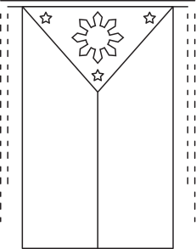
Leaders of the First Philippine Republic played crucial roles in the country's struggle for independence from Spanish and American colonial rule.

Slide 3
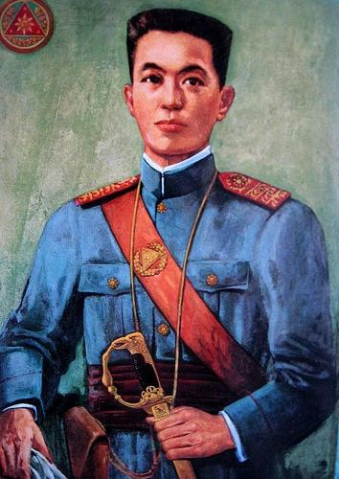
Emilio Aguinaldo
Aguinaldo is often considered the first president of the Philippines, serving as the head of the revolutionary government during the Philippine Revolution against Spanish rule and later as the president of the First Philippine Republic.
Born on March 22, 1869, Aguinaldo became a prominent figure in the fight against Spanish colonialism. He proclaimed Philippine independence on June 12, 1898, in Kawit, Cavite.

Slide 4
Aguinaldo continued to lead the Philippine forces against American occupation during the Philippine-American War (1899-1902). He was captured by the Americans in 1901, effectively ending organized resistance.
Despite his role in the revolution, Aguinaldo's leadership has been a subject of controversy, particularly regarding his dealings with the United States and his actions during the Philippine-American War.

Slide 5
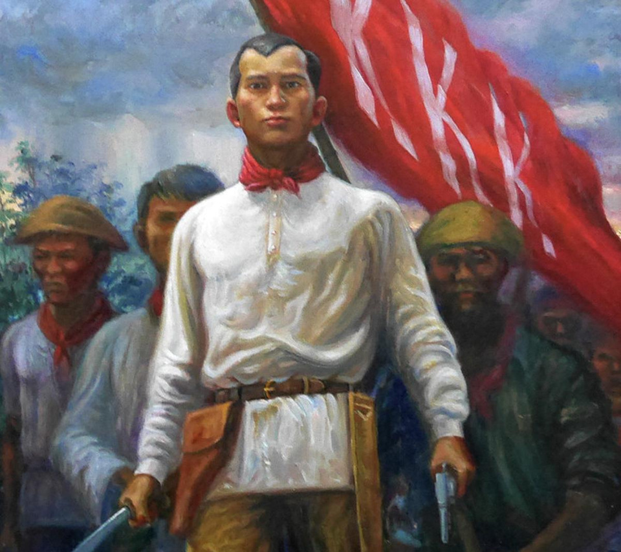
Andres Bonifacio
Bonifacio is considered one of the foremost leaders of the Philippine Revolution against Spanish rule and is often referred to as the "Father of the Philippine Revolution."
Born on November 30, 1863, Bonifacio founded the Katipunan, a secret society that aimed to overthrow Spanish colonial rule through armed revolution.

Slide 6
Bonifacio led several early uprisings against Spanish authorities and played a key role in the declaration of Philippine independence in 1896.
Despite his significant contributions, Bonifacio's leadership was challenged by Aguinaldo and other members of the revolutionary movement. He was eventually executed on May 10, 1897, after a controversial trial.

Slide 7
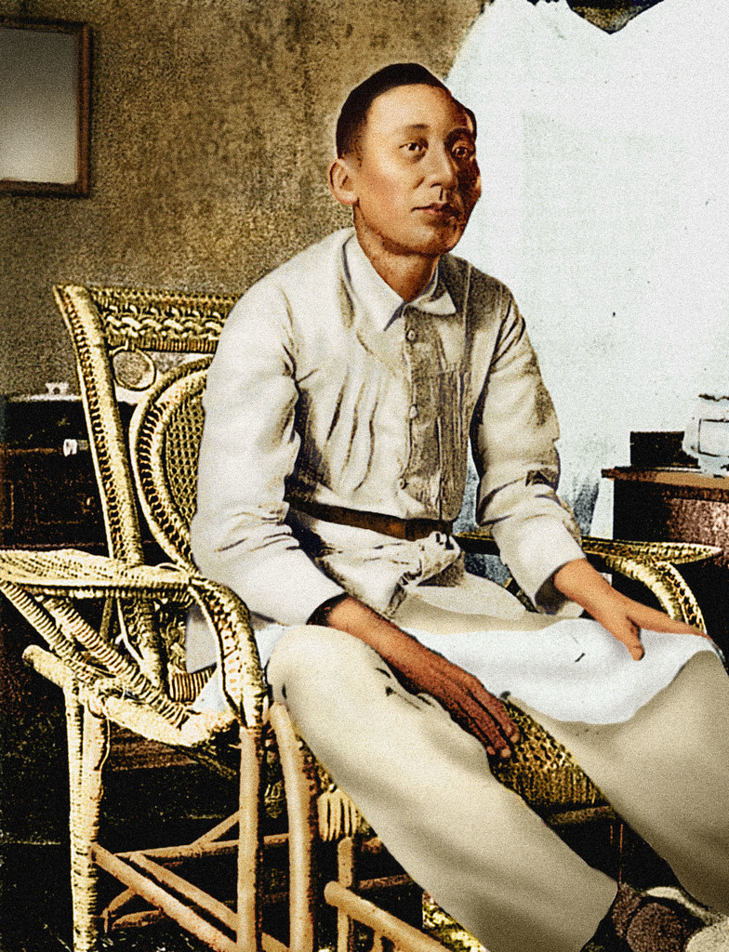
Apolinario Mabini
Mabini was a Filipino revolutionary leader, lawyer, and statesman who served as the Prime Minister of the First Philippine Republic under Aguinaldo's presidency.
Born on July 23, 1864, Mabini was known as the "Sublime Paralytic" because of his paralysis caused by polio.

Slide 8
Mabini was a key intellectual figure in the Philippine Revolution, providing legal and philosophical insights that guided the revolutionary government.
After the Philippine-American War, Mabini continued to advocate for Filipino independence and sovereignty. He died on May 13, 1903, leaving behind a legacy of principled leadership and commitment to the Filipino cause.

